Slide 1


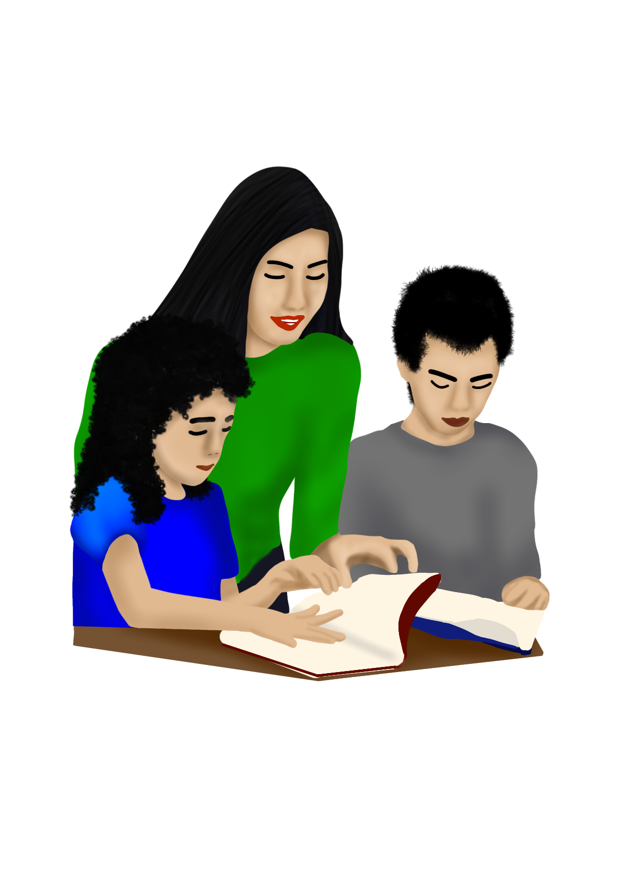
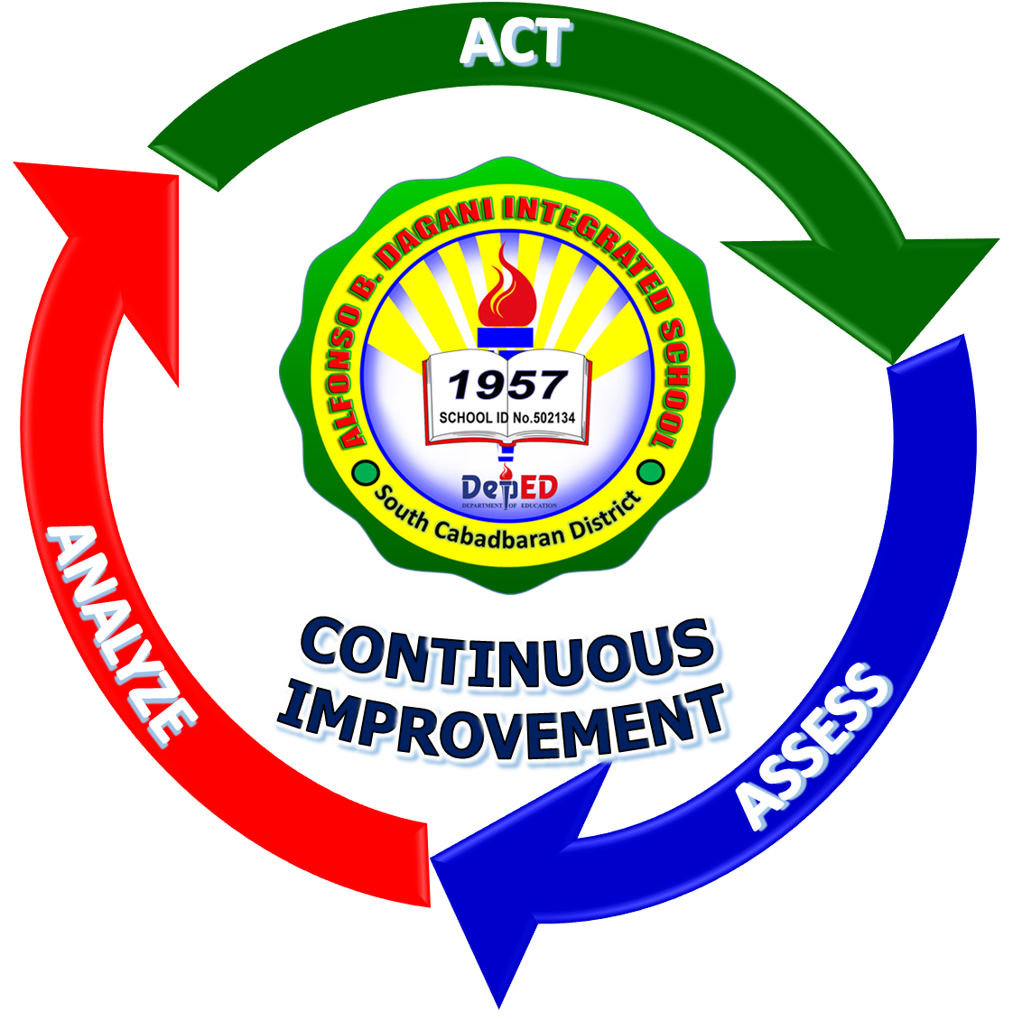
CONTEXTUALIZED AND LOCALIZED LEARNING MATERIALS FOR
READING INTERVENTION
STEP 4:
BLENDING SOUNDS
Alfonso B. Dagani Integrated School

Slide 2
DEVELOPMENT TEAM
Writers: Meriam P. Juguilon
Verna N. Magsigay
Virgelyn O. Paez
Marites A. Salabsab
Mary Jean Gladys S. Pereyra
Annabelle M. Salabao
Mary Rose E. Amper
Elvira M. Guzman
Arzylette B. Magsayo
Julieta S. Maisog
Illustrator: Arzylette B. Magsayo
Layout Artist: Arzylette B. Magsayo
Learning Resource Manager: (School LR Manager)Ailyn T. Estorba
(School Principal) Joel A. Mejorada
Alfonso B. Dagani Integrated School

Slide 3
Step 4
BLENDING SOUNDS

Slide 4
Blending Sounds
Objective: Tumong: | 1. Pronounce the consonant blend that starts each object's name through picture clues. Ipahayag ang consonant blend nga nagsugod sa ngalan sa matag butang pinaagi sa gihatag nga hulagway.

Slide 5

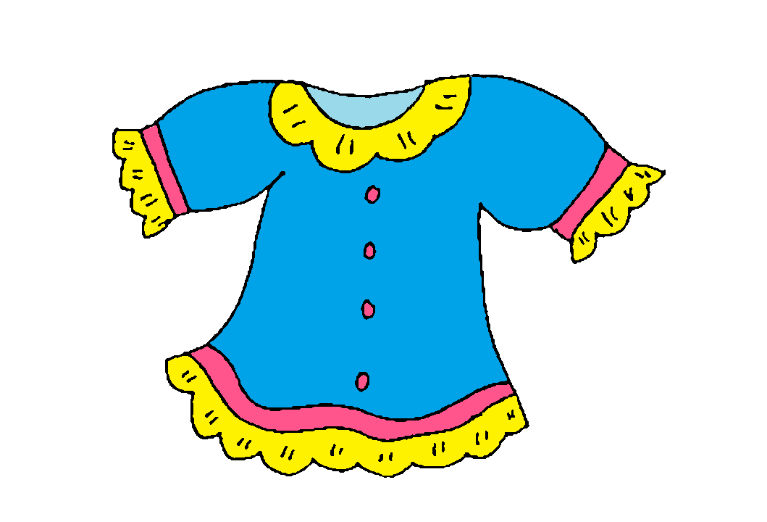
Sample:
Teacher: b + l + u = blu, ikaw
Bata: b + l + u = blu
Teacher: Sakto, blu sama sa blusa
b
l
b
l
u
blu
u
blu
t
s
t
s
i
tsi
i
tsi
+
+
+
+
+
+
=
+
+
=
=
=

Slide 6
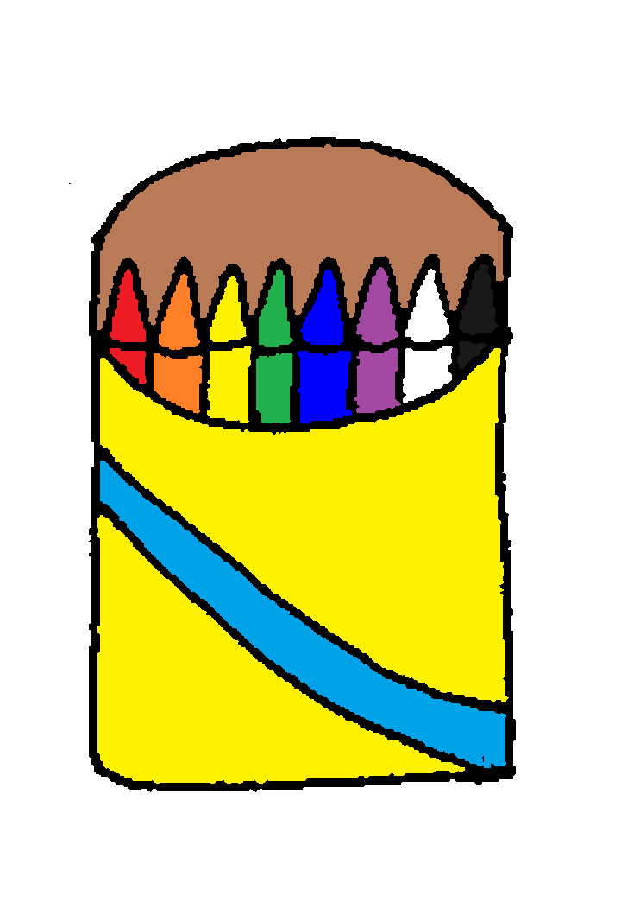

k
r
k
r
a
kra
a
kra
p
l
p
l
a
pla
a
pla
+
+
+
+
+
+
=
+
+
=
=
=

Slide 7

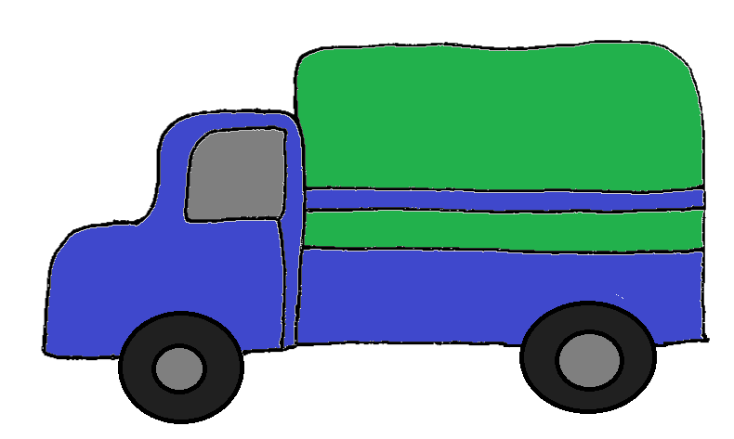
t
r
t
r
a
tra
a
tra
k
r
k
r
u
kru
u
kru
+
+
+
+
+
+
=
+
+
=
=
=

Slide 8
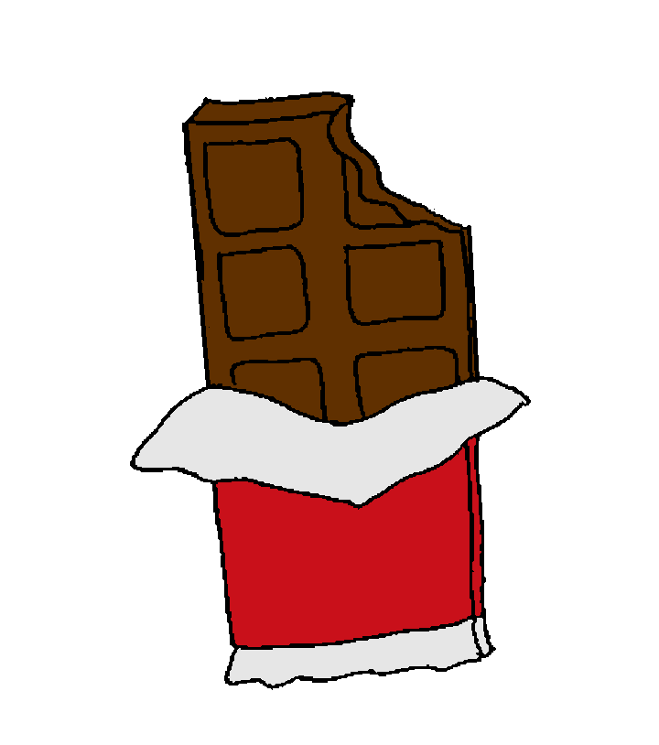

p
r
p
r
u
pru
u
pru
t
s
t
s
o
tso
o
tso
+
+
+
+
+
+
=
+
+
=
=
=

Slide 9
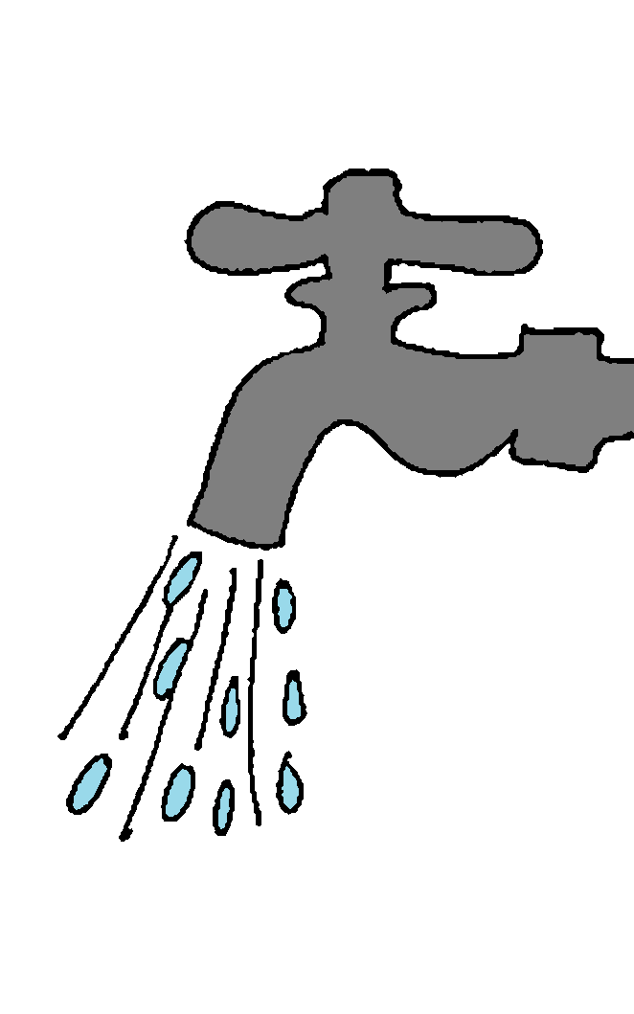
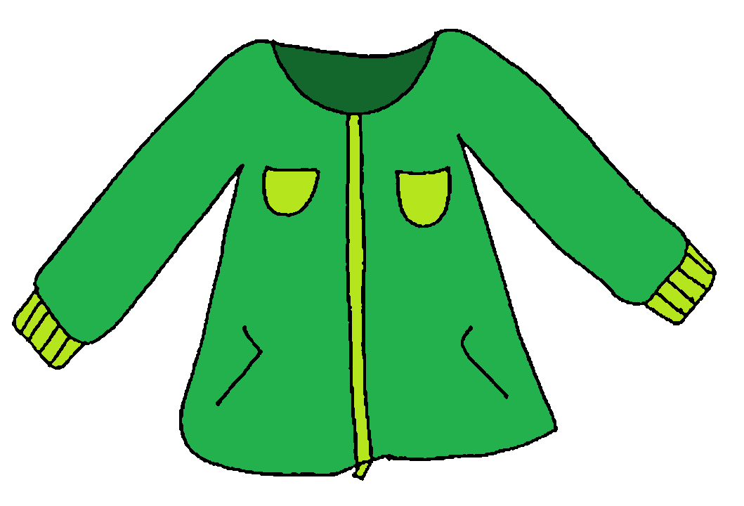
g
r
g
r
i
gri
i
gri
d
y
d
y
a
dya
a
dya
+
+
+
+
+
+
=
+
+
=
=
=

Slide 10

k
w
k
w
e
kwe
e
kwe
p
r
p
r
e
pre
e
pre
+
+
+
+
+
+
=
+
+
=
=
=

Slide 11


k
w
k
w
a
kwa
a
kwa
t
r
t
r
a
tra
a
tra
+
+
+
+
+
+
=
+
+
=
=
=

Slide 12


t
r
t
r
e
tre
e
tre
t
r
t
r
a
tra
a
tra
+
+
+
+
+
+
=
+
+
=
=
=

Slide 13


ng
ng
a
nga
ng
a
nga
ng
i
ngi
i
ngi
+
+
+
=
+
=
=
=

Slide 14
Congratulations

